Slide 1
Software Engineering
Wei-Min Wu（吴为民）
School of Petroleum
China University of Petroleum - Beijing at Karamay
Fall, 2025

Slide 2
Chap. 2 Software Processes
Topics covered
Software process models 软件过程模型
Process activities 过程活动
Coping with change 应对变化
Process improvement 过程改进

Slide 3
Chap. 2 Software Processes
The software process 软件过程
A structured set of activities required to develop a software system. 开发软件的一组活动
Many different software processes but all involve:
Specification – defining what the system should do; 规格说明
Design and implementation – defining the organization of the system and implementing the system; 设计和实现
Validation – checking it does what the customer wants; 确认
Evolution – changing the system in response to changing customer needs. 演化
A software process model is an abstract representation of a process. 软件过程模型：过程的抽象表示

Slide 4
Chap. 2 Software Processes
Software process descriptions 过程描述
When discuss processes, we usually talk about the activities in these processes such as specifying a data model, designing a user interface, etc. and the ordering of these activities. 通常指:活动及次序
Process descriptions may also include: 还包括
Products, the outcomes of a process activity; 产物
Roles, which reflect the responsibilities of the people involved in the process; 角色
Pre- and post-conditions, which are statements that are true before and after a process activity has been enacted or a product produced. 前/后置条件

Slide 5
Chap. 2 Software Processes
Plan-driven and agile processes 两类过程
Professional Professional software development is a managed activity, so planning is an inherent part of all processes. 计划是所有过程的固有部分
Plan-driven processes are processes where all of the process activities are planned in advance and progress is measured against this plan; 计划驱动的过程
In agile processes, planning is incremental and it is easier to change the process to reflect changing customer requirements. 敏捷过程
Generally, for large systems, you need to find a balance between plan-driven and agile processes. 对于大系统，要做权衡

Slide 6
Chap. 2 Software Processes
Software process models 软件过程模型
The waterfall model 瀑布模型
Plan-driven model. Takes the fundamental process activities and represents them as separate process phases (requirements specification, software design, implementation, testing)
Incremental development 增量式开发
Specification, development and validation are interleaved. May be plan-driven or agile.
Integration and configuration 集成和配置
The system is assembled from existing configurable components. May be plan-driven or agile.
In practice, most large systems are developed using a process that incorporates elements from all of these models.

Slide 7
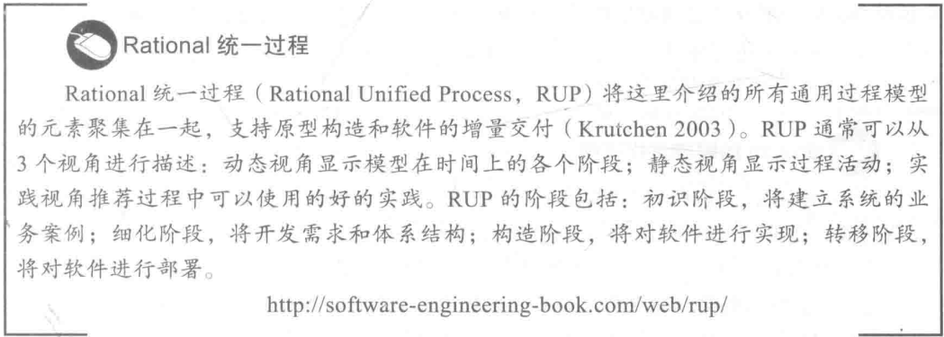
Chap. 2 Software Processes
知识链接
• 有一些组织和个人试图在所有这些通用模型基础上开发出一种“普遍适用”的过程模型，其中最广为人知的是由美国的Rational公司开发的Rational统一过程（Rational Unified Process，RUP）。RUP是一种灵活的模型，可以通过不同的方式进行实例化以创建与这里所介绍的任何一个通用过程模型相似的过程。RUP在一些大型软件公司（特别是IBM）得到了采用，但并没有被广泛接受。

Slide 8
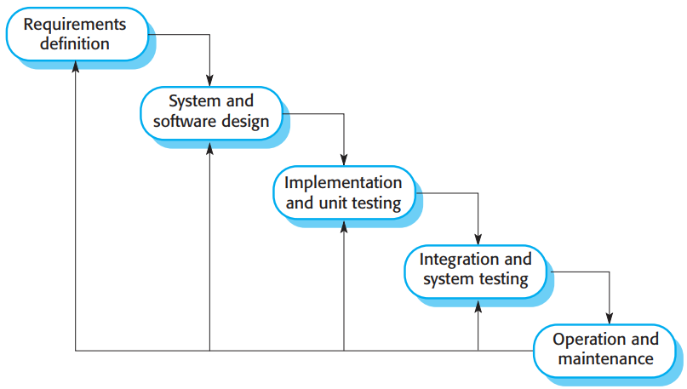
Chap. 2 Software Processes
The waterfall model 瀑布模型
• It presents the software development process as a number of stages.
• In principle at least, you plan and schedule all of the process activities before starting software development.

Slide 9
Chap. 2 Software Processes
Waterfall model phases 阶段
There are separate identified phases in the waterfall model:
Requirements analysis and definition 需求分析和定义
System and software design 系统和软件设计
Implementation and unit testing 实现和单元测试
Integration and system testing 集成和系统测试
Operation and maintenance 运行和维护
The main drawback of the waterfall model is the difficulty of accommodating change after the process is underway. In principle, a phase has to be complete before moving onto the next phase.

Slide 10
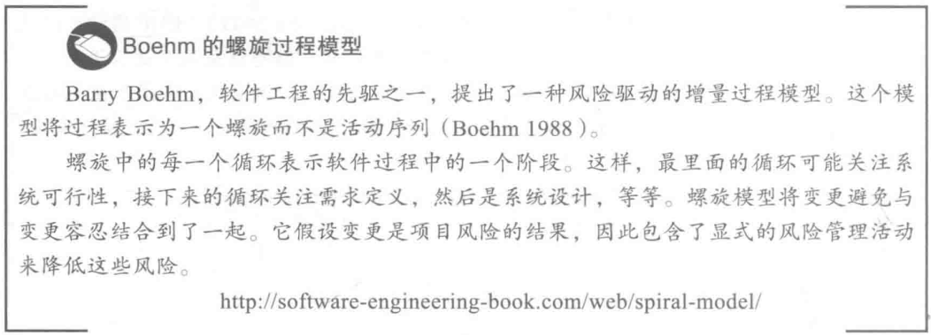
Chap. 2 Software Processes
知识链接

Slide 11
Chap. 2 Software Processes
Waterfall model problems 缺点
Inflexible partitioning of the project into distinct stages makes it difficult to respond to changing customer requirements. 响应客户需求变化困难
Therefore, this model is only appropriate when the requirements are well-understood and changes will be fairly limited during the design process.
Few business systems have stable requirements.
It is mostly used for large engineering projects where a system is developed at several sites. 多适用于大工程项目
In those circumstances, the plan-driven nature of the waterfall model helps coordinate the work.

Slide 12
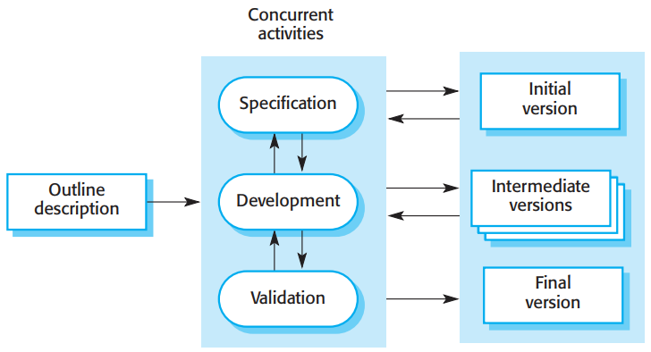
Chap. 2 Software Processes
Incremental development 增量式开发

Slide 13
Chap. 2 Software Processes
What is incremental development ?
It is based on the idea of developing an initial implementation, getting feedback from users and others, and evolving the software through several versions until the required system has been developed. 初始实现->用户反馈->多版本演化->最终版本
Specification, development, and validation activities are interleaved rather than separate, with rapid feedback across activities. 各个活动交织在一起，活动间快速反馈

Slide 14
Chap. 2 Software Processes
What is incremental development ? cont’d
It is now the most common approach for the development of application systems and software products. 目前最常见
This approach can be either plan-driven, agile or, more usually, a mixture of these approaches.
In a plan-driven approach, the system increments are identified in advance;
if an agile approach is adopted, the early increments are identified, but the development of later increments depends on progress and customer priorities.

Slide 15
Chap. 2 Software Processes
Incremental development benefits 优点
The cost of implementing requirements changes is reduced. 降低了需求变更的实现成本
The amount of analysis and documentation that has to be redone is much less than is required with the waterfall model.
It is easier to get customer feedback on the development work that has been done.更易得到反馈
Customers can comment on demonstrations of the software and see how much has been implemented.
More rapid delivery and deployment of useful software to the customer is possible. 快速交付和部署
Customers are able to use and gain value from the software earlier than with a waterfall process.

Slide 16
Chap. 2 Software Processes
Incremental development problems 缺点
The process is not visible. 过程不可见
Managers need regular deliverables to measure progress. If systems are developed quickly, it is not cost-effective to produce documents that reflect every version of the system.
System structure tends to degrade as new increments are added. 系统结构逐渐退化
Unless time and money is spent on refactoring to improve the software, regular change tends to corrupt its structure. Incorporating further software changes becomes increasingly difficult and costly.

Slide 17
Chap. 2 Software Processes
Integration and configuration 集成和配置
Based on software reuse where systems are integrated from existing components. 基于软件重用
Reuse-oriented approaches rely on a base of reusable software components and an integrating framework for the composition of these components. 软件组件+集成框架
Reused elements may be configured to adapt their behaviour and functionality to a user’s requirements.
Reuse is now the standard approach for building many types of business system. 目前是标准方法

Slide 18
Chap. 2 Software Processes
Types of reusable software
Stand-alone application systems (sometimes called COTS) that are configured for use in a particular environment. COTS
Collections of objects that are developed as a package to be integrated with a component framework such as .NET or J2EE. 对象包
Web services that are developed according to service standards and which are available for remote invocation. Web服务
COTS：Commercial Off-The-Shelf

Slide 19
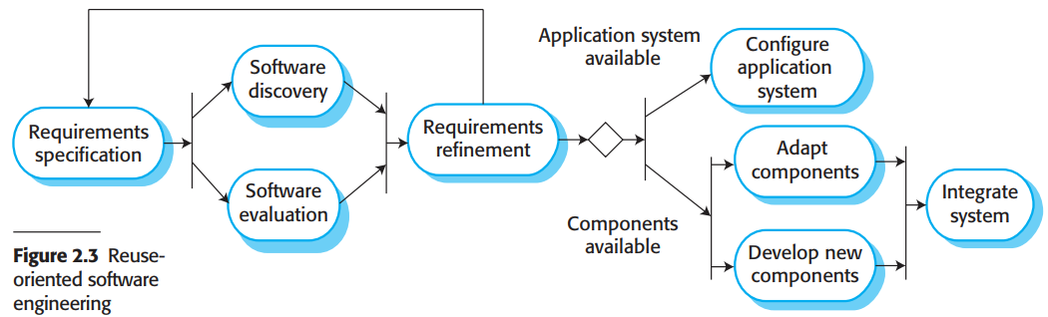
Chap. 2 Software Processes
Reuse-oriented software engineering
• Key process stages
♦ Requirements specification 需求规格说明
♦ Software discovery and evaluation 软件发现和评估
♦ Requirements refinement 需求精化
♦ Application system configuration 应用系统配置
♦ Component adaptation and integration 构件适配和集成

Slide 20
Chap. 2 Software Processes
Advantages and disadvantages 优缺点
Reduced costs and risks as less software is developed from scratch 降低成本和风险
Faster delivery and deployment of system 快速交付和部署
But requirements compromises are inevitable so system may not meet real needs of users 可能不满足用户的真正需求
Loss of control over evolution of reused system elements. 失去对重用系统演化的控制

Slide 21
Chap. 2 Software Processes
Process activities 过程活动
Real software processes are inter-leaved sequences of technical, collaborative and managerial activities with the overall goal of specifying, designing, implementing and testing a software system. 软件过程：技术、协作、管理三活动交织的过程
Generally, processes are now tool-supported. This means that software developers may use a range of software tools to help them, such as requirements management systems, design model editors, program editors, automated testing tools, and debuggers. 是工具支持的

Slide 22
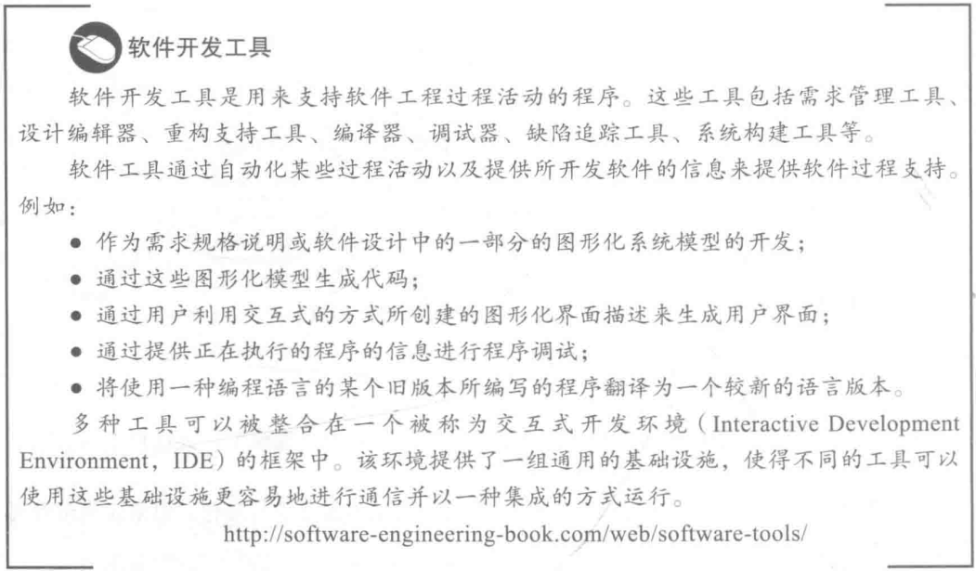
Chap. 2 Software Processes
知识链接

Slide 23
Chap. 2 Software Processes
The requirements engineering 需求工程
Software specification or requirements engineering (RE) is the process of understanding and defining what services are required from the system and identifying the constraints on the system’s operation and development. 服务需求+约束
It is a particularly critical stage of the software process, as mistakes made at this stage inevitably lead to later problems in the system design and implementation.
It aims to produce an agreed requirements document that specifies a system satisfying stakeholder requirements.
Requirements are usually presented at two levels of detail. End-users and customers need a high-level statement of the requirements; system developers need a more detailed system specification.

Slide 24
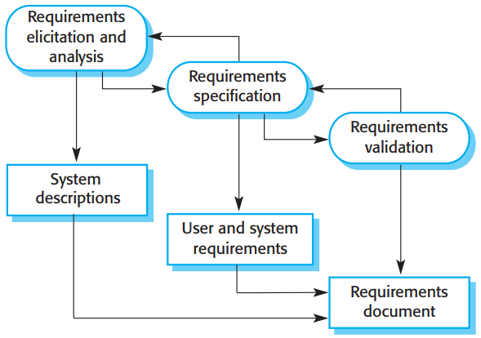
Chap. 2 Software Processes
The requirements engineering process

Slide 25
Chap. 2 Software Processes
Software specification
Three main activities in the RE process 主要RE过程
Requirements elicitation and analysis 需求抽取和分析
What do the system stakeholders require from the system?
Requirements specification 需求规格说明
Defining the requirements in detail.
Requirements validation 需求确认
Checking the validity of the requirements.
Requirements analysis continues during definition and specification, and new requirements come to light throughout the process. Therefore, the activities of analysis, definition, and specification are interleaved. 持续进行，新需求出现，活动交织

Slide 26
Chap. 2 Software Processes
Software design and implementation 设计和实现
The process of converting the system specification into an executable system. 规格说明->可执行系统
Software design 设计
Design a software structure that realises the specification;
Implementation 实现
Translate this structure into an executable program;
The activities of design and implementation are closely related and may be inter-leaved. 设计与实现：紧密相关，相互交织

Slide 27
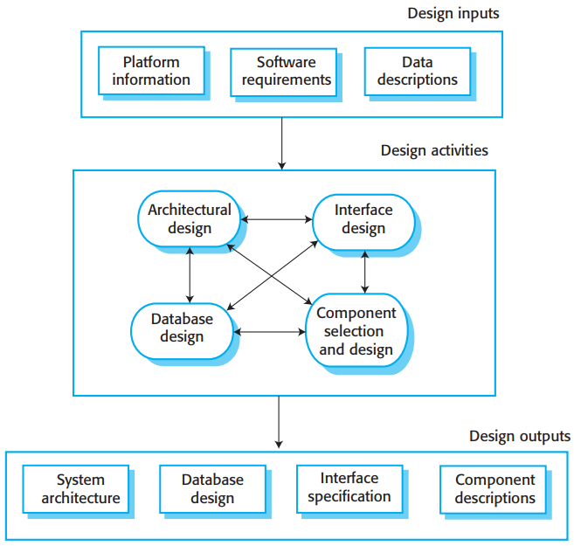
Chap. 2 Software Processes
A general model of the design process
• The design process activities are both interleaved and interdependent. New information about the design is constantly being generated, and this affects previous design decisions. Design rework is therefore inevitable.

Slide 28
Chap. 2 Software Processes
Design activities 设计活动
Architectural design, where you identify the overall structure of the system, the principal components (subsystems or modules), their relationships and how they are distributed. 架构设计
Database design, where you design the system data structures and how these are to be represented in a database. 数据库设计
Interface design, where you define the interfaces between system components. 接口设计
Component selection and design, where you search for reusable components. If unavailable, you design new components. 组件选择和设计

Slide 29
Chap. 2 Software Processes
System implementation 系统实现
The software is implemented either by developing a program or by configuring an application system. 或者开发程序，或者配置系统
Design and implementation are interleaved activities for most types of software system. 多数系统：设计和实现交织
Programming is an individual activity with no standard process. 编程无标准
Debugging is the activity of finding program faults and correcting these faults. 调试

Slide 30
Chap. 2 Software Processes
Software validation 软件确认
Verification and validation (V & V) is intended to show that a system conforms to its specification and meets the requirements of the system customer. 验证和确认
Involves checking and review processes and system testing. 检查+评审+测试
System testing involves executing the system with test cases that are derived from the real data to be processed by the system. 系统测试
Testing is the most commonly used V & V activity. 测试最常用

Slide 31
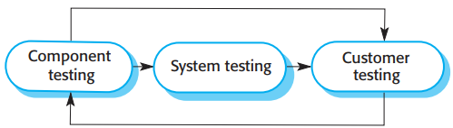
Chap. 2 Software Processes
Stages of testing 测试的阶段
• Figure 2.6 shows a three-stage testing process in which system components are individually tested, then the integrated system is tested. 三阶段测试过程
• For custom software, customer testing involves testing the system with real customer data.
• For products that are sold as applications, customer testing is sometimes called beta testing where selected users try out and comment on the software. β测试

Slide 32
Chap. 2 Software Processes
Testing stages 测试阶段
Component testing 组件测试
Individual components are tested independently;
Components may be functions or objects or coherent groupings of these entities.
System testing 系统测试
Testing of the system as a whole. Testing of emergent properties is particularly important.
Customer testing 客户测试
Testing with customer data to check that the system meets the customer’s needs.

Slide 33
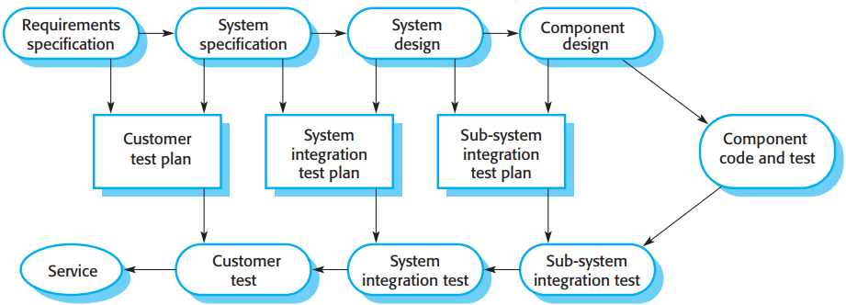
Chap. 2 Software Processes
Testing phases in a plan-driven software process
• When a plan-driven software process is used (e.g., for critical systems development), testing is driven by a set of test plans. An independent team of testers works from these test plans, which have been developed from the system specification and design. Figure 2.7 illustrates how test plans are the link between testing and development activities.
• This is called the V-model of development (turn it on its side to see the V). The V-model shows the software validation activities that correspond to each stage of the waterfall process model.

Slide 34
Chap. 2 Software Processes
Software evolution 软件演化
Software is inherently flexible and can change. 软件：灵活、可变化
As requirements change through changing business circumstances, the software that supports the business must also evolve and change. 软件随业务需求演化
This distinction between development and maintenance is increasingly irrelevant. Very few software systems are completely new systems, and it makes much more sense to see development and maintenance as a continuum. 将开发和维护看做一个连续整体更合理

Slide 35
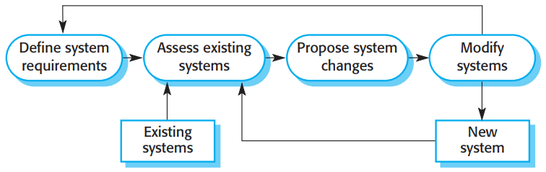
Chap. 2 Software Processes
Software evolution cont’d
• Rather than two separate processes, it is more realistic to think of software engineering as an evolutionary process (Figure 2.8) where software is continually changed over its lifetime in response to changing requirements and customer needs.

Slide 36
Chap. 2 Software Processes
Coping with change 应付变化
Change is inevitable in all large software projects. 变化不可避免
Business changes lead to new and changed system requirements.
New technologies open up new possibilities for improving implementations.
Changing platforms require application changes.
Change leads to rework so the costs of change include both rework (e.g. re-analysing requirements) as well as the costs of implementing new functionality 变化->返工->成本(需求再分析+实现新功能)

Slide 37
Chap. 2 Software Processes
Reducing the costs of rework 降低返工成本
Change anticipation, where the software process includes activities that can anticipate possible changes before significant rework is required. 变化预见
For example, a prototype may be developed to show some key features of the system to customers. 制作原型
Change tolerance, where the software are designed so that changes can be easily made to the system. 变化容忍
This normally involves some form of incremental development. Proposed changes may be implemented in increments that have not yet been developed. If this is impossible, then only a single increment (a small part of the system) may have be altered to incorporate the change. 增量式开发，变化以增量来实现，或者只修改单个增量

Slide 38
Chap. 2 Software Processes
Coping with changing requirements 应付变化需求
System prototyping, where a version of the system or part of the system is developed quickly to check the customer’s requirements and the feasibility of design decisions. This approach supports change anticipation. 系统原型
Incremental delivery, where system increments are delivered to the customer for comment and experimentation. This supports both change avoidance and change tolerance. 增量式交付
• Refactoring, namely, improving the structure and organization of a program, is also an important mechanism that supports change tolerance, which will be discussed in Chapter 3. 重构

Slide 39
Chap. 2 Software Processes
Software prototyping 软件原型
A prototype is an initial version of a system used to demonstrate concepts and try out design options. 用于演示概念和尝试设计选项
A prototype can help anticipate changes in: 有助于预见变化
In the requirements engineering process, a prototype can help with the elicitation and validation of system requirements; 在需求过程：有助于抽取和确认系统需求
In the system design process, a prototype can be used to explore software solutions and in the development of a user interface for the system. 在设计过程：有助于探索解决方案，及用户界面开发

Slide 40
Chap. 2 Software Processes
Benefits of prototyping 原型的益处
Prototypes allow potential users to see how well the system supports their work. 能看出:系统支持情况
They may get new ideas for requirements and find strength and weakness in the software, then propose new system requirements. 发现强、弱点，提出新需求
Furthermore, as the prototype is developed, it may reveal errors and omissions in the system requirements. 发现需求错误和遗漏
A prototype may be used while the system is being designed to carry out design experiments to check the feasibility of a proposed design. 检验设计的可行性

Slide 41
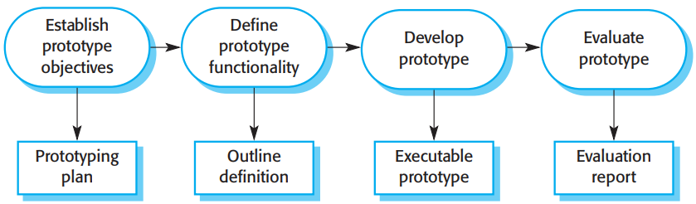
Chap. 2 Software Processes
The process of prototype development
• The objectives of prototyping should be made explicit from the start of the process. 明确原型目标
• The next stage is to decide what to put into and, perhaps more importantly, what to leave out of the prototype system. 确定在原型系统中纳入/排除哪些功能
• The final stage of the process is prototype evaluation.原型评估

Slide 42
Chap. 2 Software Processes
Incremental delivery 增量式交付
Rather than deliver the system as a single delivery, the delivery is broken down into increments with each increment delivering part of the required functionality. 交付分解为增量
User requirements are prioritised and the highest priority requirements are included in early increments. 高优先权需求包含于早期增量中
Once the development of an increment is started, the requirements are frozen though requirements for later increments can continue to evolve. 一旦开始开发，当前需求冻结，后续增量的需求继续演化

Slide 43
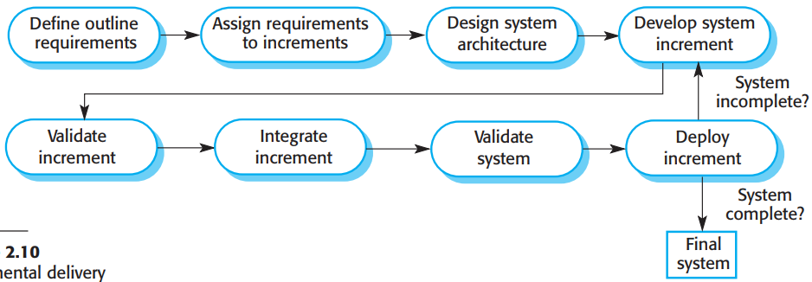
Chap. 2 Software Processes
Incremental delivery
• Once the increments have been identified, the requirements for the services to be delivered in the first increment are defined in detail and that increment is developed.
• During development, further requirements analysis for later increments can take place, but requirements changes for the current increment are not accepted.
• Once an increment is completed and delivered, it is installed in the customer’s working environment. They can experiment with the system, and this helps them clarify their requirements for later system increments.
• As new increments are completed, and integrated with existing increments, system functionality improves with each delivered increment.

Slide 44
Chap. 2 Software Processes
Incremental delivery advantages 优势
Early increments act as a prototype to help elicit requirements for later increments. 早期增量扮演原型角色，帮助抽取后续增量的需求
Customers do not have to wait until the entire system is delivered before they can gain value from it. 早受益
The process maintains the benefits of incremental development in that it is easy to incorporate changes into the system. 易引入改变
The highest priority system services tend to receive the most testing. 高优先权服务获得最多测试

Slide 45
Chap. 2 Software Processes
Incremental delivery problems 存在的问题
Iterative delivery is problematic when the new system is intended to replace an existing system. Users need all of the functionality of the old system and are unwilling to experiment with an incomplete new system.
Most systems require a set of basic facilities that are used by different parts of the system. As requirements are not defined in detail until an increment is to be implemented, it can be hard to identify common facilities that are needed by all increments.
The essence of iterative processes is that the specification is developed in conjunction with the software. However, this conflicts with the procurement model of many organizations, where the complete system specification is part of the system development contract.

Slide 46
Chap. 2 Software Processes
Process improvement 过程改进
Many software companies have turned to software process improvement as a way of enhancing the quality of their software, reducing costs or accelerating their development processes. 过程改进：作为增强软件质量、降低成本，加速开发过程的途径
Process improvement means understanding existing processes and changing these processes to increase product quality and/or reduce costs and development time. 意味着：理解现有过程，改变这些过程，以提高产品质量、降低成本和开发时间

Slide 47
Chap. 2 Software Processes
Approaches to improvement 改进的途径：2种
The process maturity approach, which focuses on improving process and project management and introducing good software engineering practice. 过程成熟度方法:关注过程改进和项目管理，引入好的软件工程实践。
The level of process maturity reflects the extent to which good technical and management practice has been adopted in software development processes.
The agile approach, which focuses on iterative development and the reduction of overheads in the software process. 敏捷方法:专注迭代开发和减少开销。
The primary characteristics of agile methods are rapid delivery of functionality and responsiveness to changing customer requirements.

Slide 48
Chap. 2 Software Processes
The process improvement cycle 过程改进循环
• The general process improvement process underlying the process maturity approach is a cyclical process, as shown in Figure 2.11.
基于过程成熟度的过程改进过程。

Slide 49
Chap. 2 Software Processes
Process improvement activities 过程改进活动
Process measurement ：You measure one or more attributes of the software process or product. These measurements forms a baseline that helps you decide if process improvements have been effective. 过程度量
Process analysis ：The current process is assessed, and process weaknesses and bottlenecks are identified. Process models (sometimes called process maps) that describe the process may be developed. 过程分析
Process change ：Process changes are proposed to address some of the identified process weaknesses. These are introduced and the cycle resumes to collect data about the effectiveness of the changes. 过程改变

Slide 50
Chap. 2 Software Processes
About process maturity 关于过程成熟度
The notion of process maturity was introduced in the late 1980s when the Software Engineering Institute (SEI) proposed their model of process capability maturity. 过程成熟度观念的起源
The maturity of a software company’s processes reflects the process management, measurement, and use of good software engineering practices in the company.
This idea was introduced so that the U.S. Department of Defense could assess the SE capability of defense contractors, with a view to limiting contracts to those who had reached a required level of process maturity.
Five levels of process maturity were proposed.

Slide 51
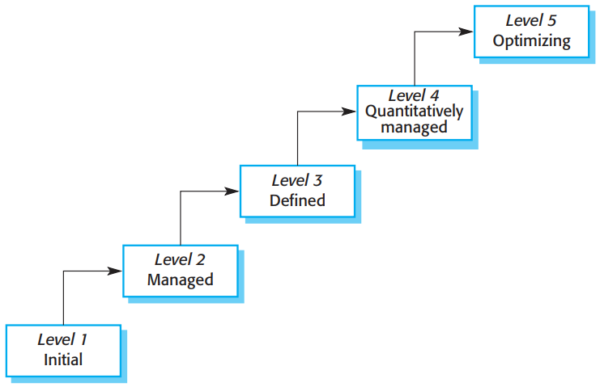
Chap. 2 Software Processes
Capability maturity levels 能力成熟度等级
优化级
定量管理级
被定义级
受管理级
初始级

Slide 52
Chap. 2 Software Processes
The SEI capability maturity model 能力成熟度模型
Initial: The goals associated with the process area are satisfied, and for all processes the scope of the work to be performed is explicitly set out and communicated to the team members. 初始级:目标满足,工作实施范围已界定并传达。 Managed: The goals associated with the process area are met, and organizational policies are in place that define when each process should be used. There must be documented project plans that define the project goals. Resource management and process monitoring procedures must be in place across the institution. 受管理级:目标满足,组织的政策到位。必须有书面化的项目计划。资源管理及流程监控到位。

Slide 53
Chap. 2 Software Processes
The SEI capability maturity model, cont’d
Defined: Focuses on organizational standardization and deployment of processes. Each project has a managed process that is adapted to the project requirements from a defined set of organizational processes. Process assets and process measurements must be collected and used for future process improvements. 被定义级:专注于组织标准化和流程部署。每个项目都有受管理的流程，这些流程适配已定义的组织过程的项目需求。
Quantitatively managed: There is an organizational responsibility to use statistical and other quantitative methods to control subprocesses. That is, collected process and product measurements must be used in process management. 定量管理级:组织运用统计和其他量化方法来控制子流程。
Optimizing: The organization must use the process and product measurements to drive process improvement. Trends must be analyzed and the processes adapted to changing business needs. 优化级:组织利用过程和产品的度量来驱动流程改进。

Slide 54
Chap. 2 Software Processes
Key points
Software processes are the activities involved in producing a software system. Software process models are abstract representations of these processes.
General process models describe the organization of software processes.
Examples of these general models include the ‘waterfall’ model, incremental development, and reuse-oriented development.
Requirements engineering is the process of developing a software specification.

Slide 55
Chap. 2 Software Processes
Key points
Processes may be structured for iterative development and delivery so that changes may be made without disrupting the system as a whole.
The principal approaches to process improvement are agile approaches, geared to reducing process overheads, and maturity-based approaches based on better process management and the use of good software engineering practice.
The SEI process maturity framework identifies maturity levels that essentially correspond to the use of good software engineering practice.

